Slide 1
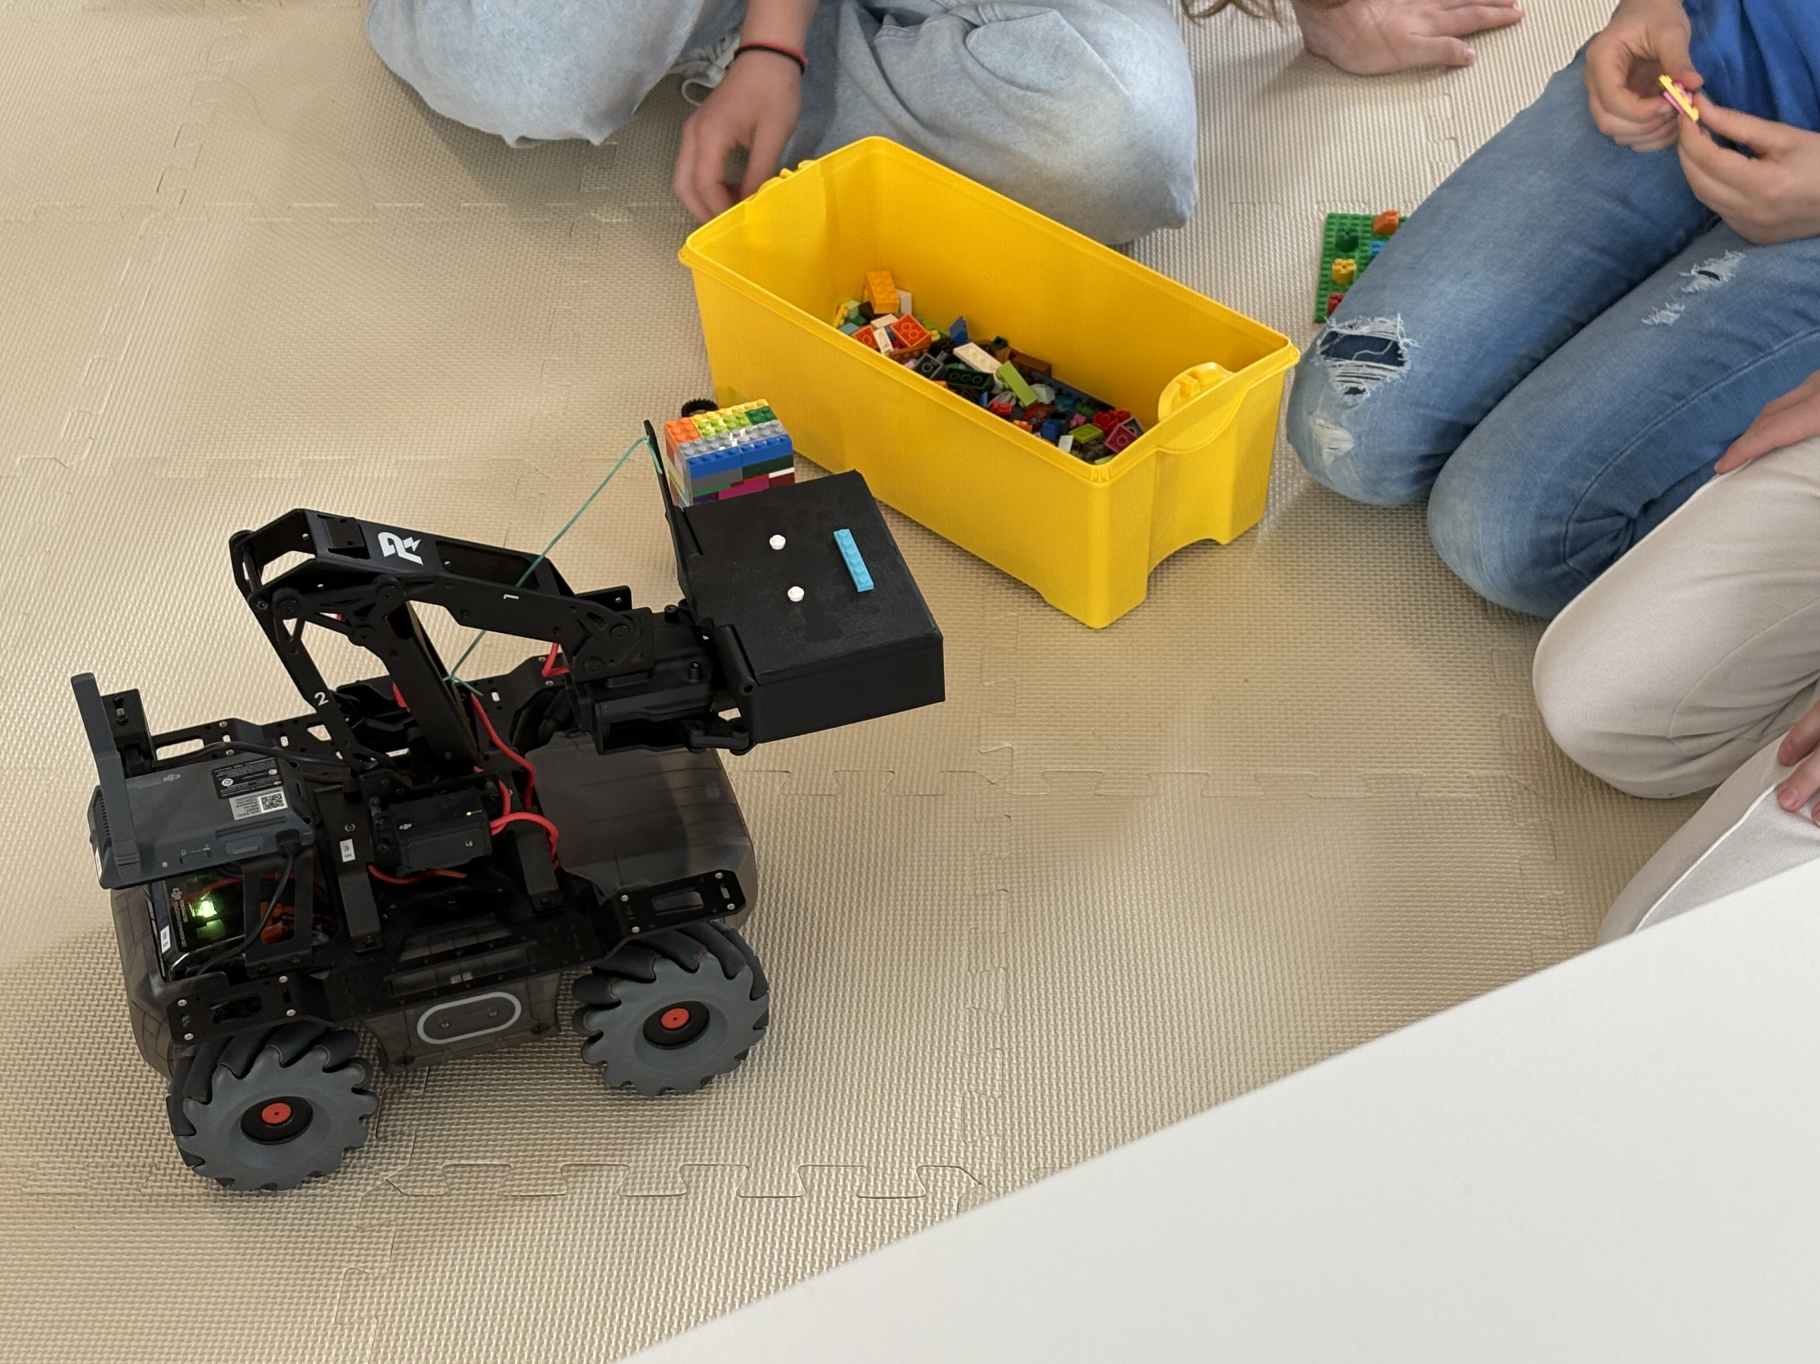
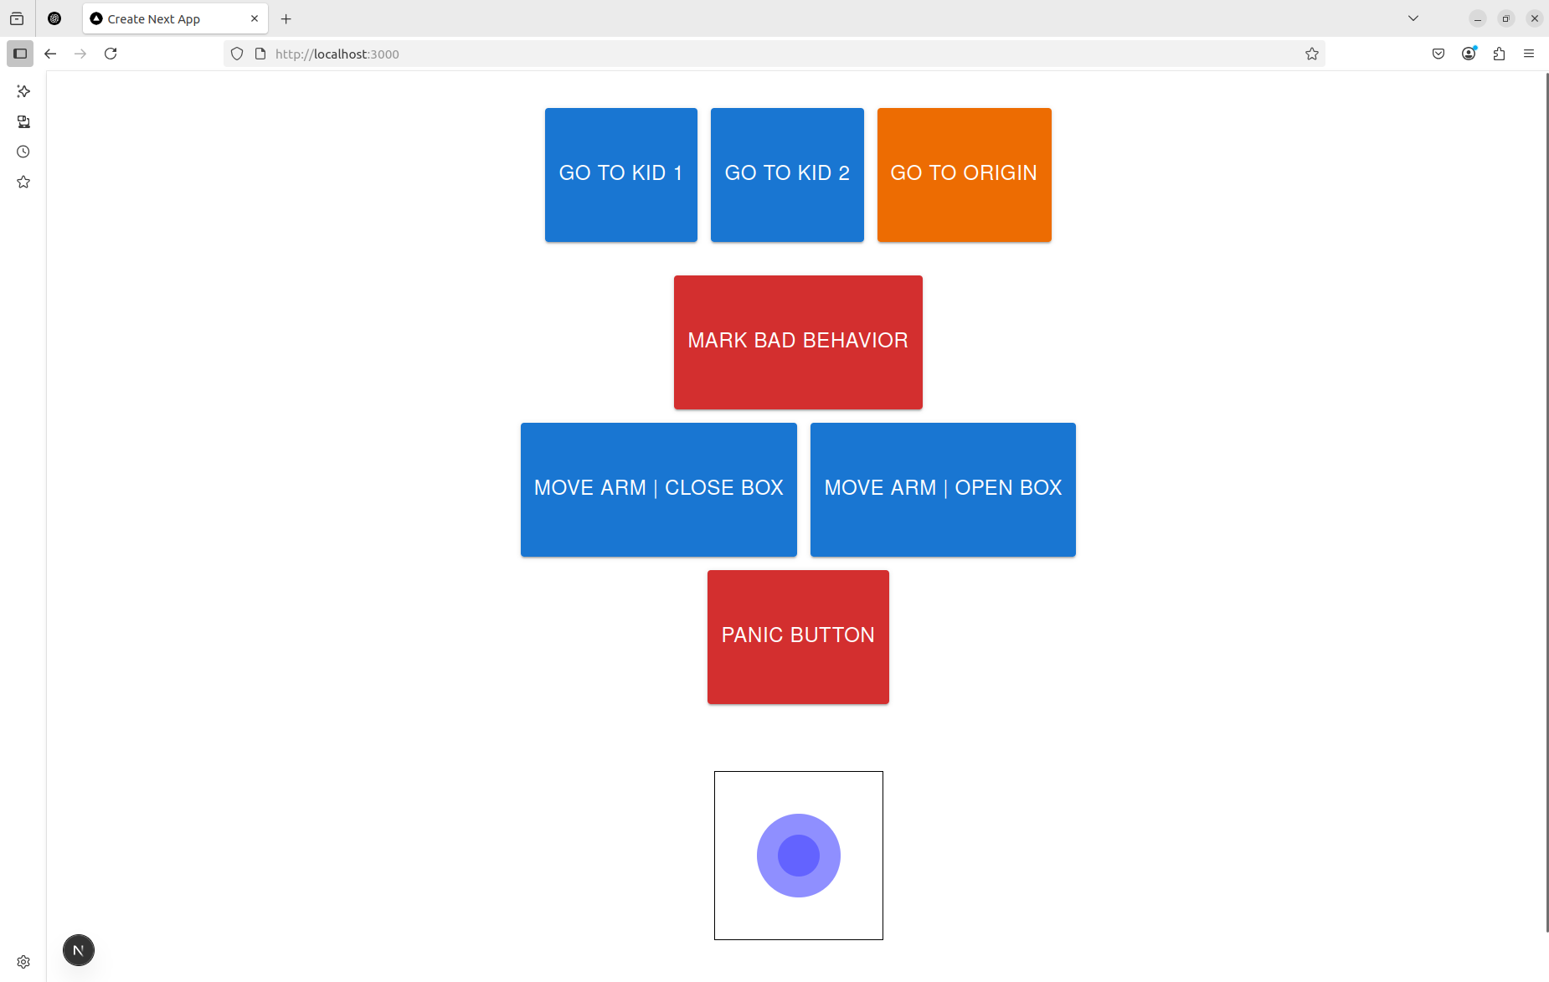
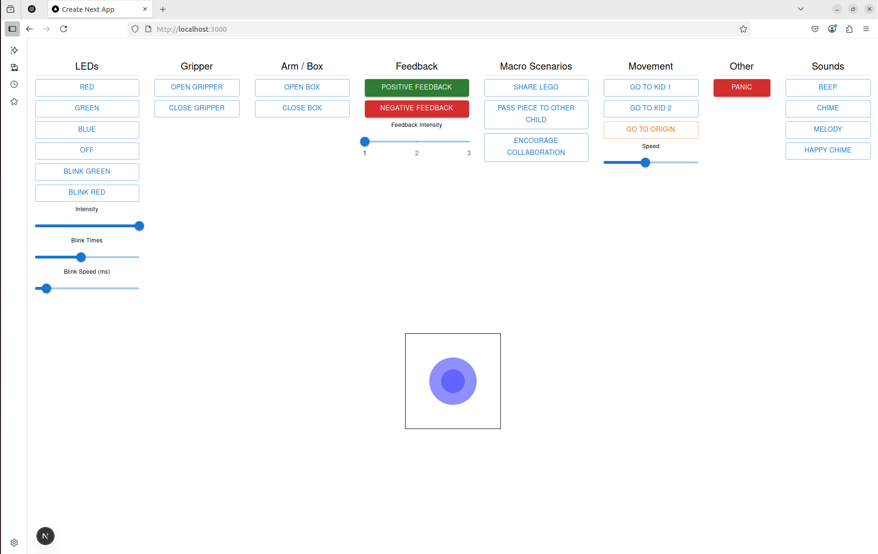
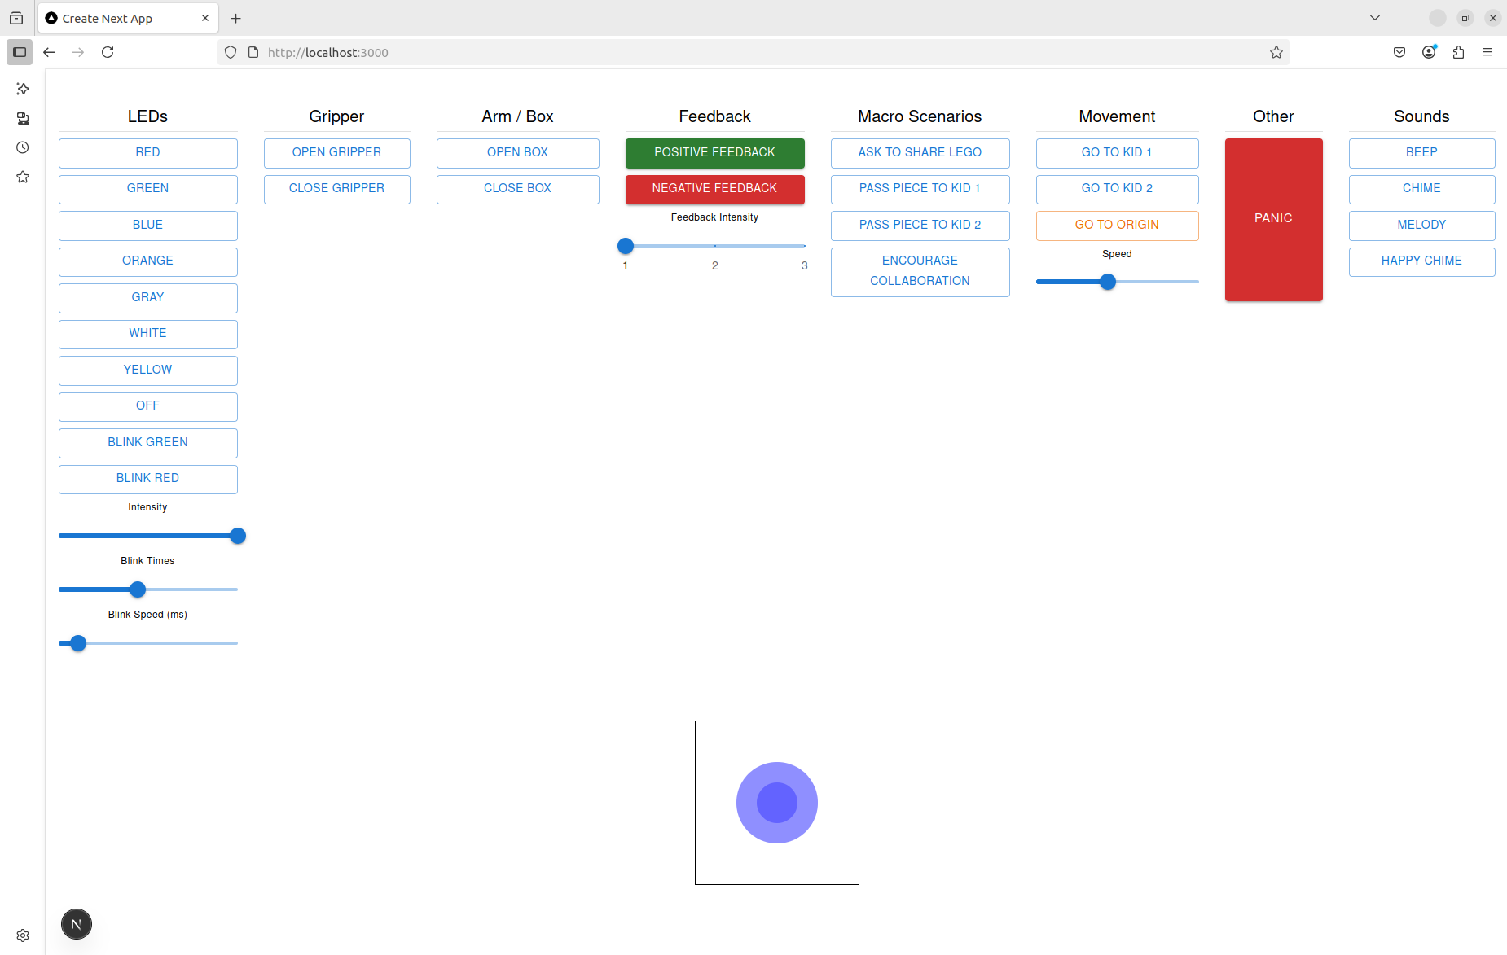

Exploring the Learning by Teaching Paradigm with Social Robots
Exploratory Studies on Learning by Teaching with Social Robots using Wizard-of-Oz Control
Student: Davide Frova
Advisor: Prof. Monica Landoni
Co-Advisor: Antonio Paolillo
Project Objectives
Develop a socially expressive Wizard-of-Oz dashboard for intuitive robot control in child-robot interaction.
Explore how children teach and shape robot behaviour in collaborative scenarios, to inform future autonomous systems.
Walkthrough 1: Expert Feedback
Fixed positions didn’t work
Children moved unpredictably during play,
making joystick control a must.
1
Negative Feedback Was Entertaining
Spinning or dramatic motions were perceived as fun, potentially reinforcing misbehaviour.
Robot Seen as a Peer
Participants related to the robot more like a peer or playful companion than an authority figure.
Walkthrough 2: High School Students
LEDs Were Ignored
Red light alone wasn’t enough to attract attention during play, especially on the floor.
Movement Was Attention-Grabbing
2
Quick approaches or changes in position effectively caught children’s focus.
Naming Boosted the Engagement
Letting children name the robot increased their sense of connection and interaction quality.
Walkthrough 3: Middle School Students
Robot Seen as a Pet
Children treated the robot like a pet (e.g., decorating or petting it), reinforcing its peer-like framing.
3
Multimodal “Dances” Were Popular
Children loved expressive combination of lights, sound, and movement for positive feedback.
Emotion and Politeness Teaching Emerged
Kids naturally started to teach the robot social behaviours like keeping distance or expressing emotion.
Key Takeaways & Next Steps
Kids engage more when the robot is framed as a peer, not authority.
Multimodal feedback sustains attention better than LEDs alone.
Next: enable emotion-aware autonomy and support teachable, adaptive behaviour.

Slide 2
Exploring the Learning by Teaching Paradigm with Social Robots
Exploratory Studies on Learning by Teaching with Social Robots using Wizard-of-Oz Control
Student: Davide Frova
Advisor: Monica Landoni
Co-Advisor: Antonio Paolillo
What happens when children teach a robot?
Goals
This project explores how children develop social understanding by teaching a robot to behave appropriately in shared activities.
Rather than programming or controlling the robot directly, children engage in a Learning by Teaching process, shaping the robot’s behaviour through interaction, correction, and feedback.
Develop a socially expressive Wizard-of-Oz dashboard for intuitive robot control in child-robot interaction.
Explore how children teach and shape robot behaviour in collaborative scenarios, to inform future autonomous systems.
Walkthrough 1: Expert Feedback
Fixed positions didn’t work
Children moved unpredictably during play,
making joystick control a must.
1
Negative Feedback Was Entertaining
Spinning or dramatic motions were perceived as fun, potentially reinforcing misbehaviour.
Robot Seen as a Peer
Participants related to the robot more like a peer or playful companion than an authority figure.
Walkthrough 2: High School Students
LEDs Were Ignored
Red light alone wasn’t enough to attract attention during play, especially on the floor.
Movement Was Attention-Grabbing
2
Quick approaches or changes in position effectively caught children’s focus.
Naming Boosted the Engagement
Letting children name the robot increased their sense of connection and interaction quality.
Walkthrough 3: Middle School Students
Robot Seen as a Pet
Children treated the robot like a pet (e.g., decorating or petting it), reinforcing its peer-like framing.
3
Multimodal “Dances” Were Popular
Children loved expressive combination of lights, sound, and movement for positive feedback.
Emotion and Politeness Teaching Emerged
Kids naturally started to teach the robot social behaviours like keeping distance or expressing emotion.
Conclusions
Future work
Children engaged more with a robot framed as a peer. The co-design process helped shape both the interface and its expressive behaviours to align with this framing.
Next steps include enabling emotion-aware autonomy and expanding the approach to broader, more diverse child populations through longer-term studies.

Slide 3
Exploring the Learning by Teaching Paradigm with Social Robots
Exploratory Studies on Learning by Teaching with Social Robots using Wizard-of-Oz Control
Student: Davide Frova
Advisor: Monica Landoni
Co-Advisor: Antonio Paolillo
What happens when children teach a robot?
Goals
This project explores how children develop social understanding by teaching a robot to behave appropriately in shared activities.
Rather than programming or controlling the robot directly, children engage in a Learning by Teaching process, shaping the robot’s behaviour through interaction, correction, and feedback.
Develop a socially expressive Wizard-of-Oz dashboard for intuitive robot control in child-robot interaction.
Explore how children teach and shape robot behaviour in collaborative scenarios, to inform future autonomous systems.
Fixed positions didn’t work
Children moved unpredictably during play,
making joystick control a must.
1
Negative Feedback Was Entertaining
Spinning or dramatic motions were perceived as fun, potentially reinforcing misbehaviour.
Robot Seen as a Peer
Participants related to the robot more like a peer or playful companion than an authority figure.
LEDs Were Ignored
Red light alone wasn’t enough to attract attention during play, especially on the floor.
Movement Was Attention-Grabbing
2
Quick approaches or changes in position effectively caught children’s focus.
Naming Boosted the Engagement
Letting children name the robot increased their sense of connection and interaction quality.
Robot Seen as a Pet
Children treated the robot like a pet (e.g., decorating or petting it), reinforcing its peer-like framing.
3
Multimodal “Dances” Were Popular
Children loved expressive combination of lights, sound, and movement for positive feedback.
Emotion and Politeness Teaching Emerged
Kids naturally started to teach the robot social behaviours like keeping distance or expressing emotion.
Conclusions
Future work
Children engaged more with a robot framed as a peer. The co-design process helped shape both the interface and its expressive behaviours to align with this framing.
Next steps include enabling emotion-aware autonomy and expanding the approach to broader, more diverse child populations through longer-term studies.

